Slide 1

Web Crawling with
Apache Nutch on Window 11
Monir, Thong

Slide 2
Installation

Slide 3
Requirements
Windows-Cygwin
JDK/ Java
Apache Solr
Apache Nutch

Slide 4
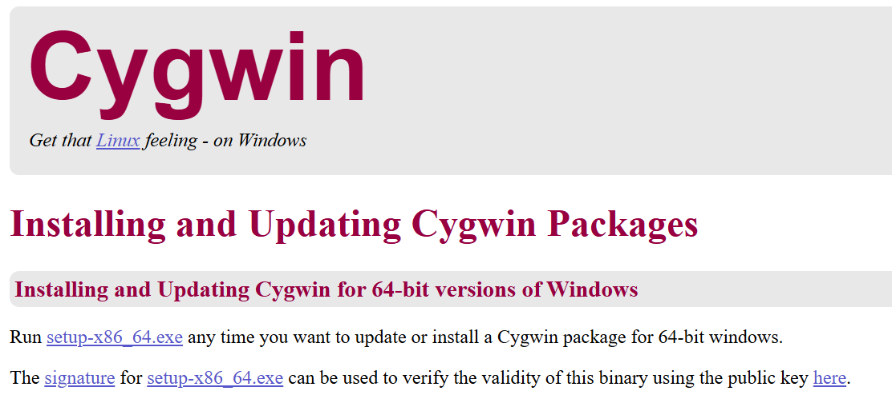
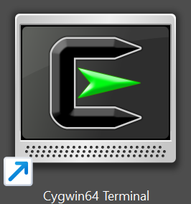
Cygwin
Download and Install:
https://www.cygwin.com/install.html

Slide 5
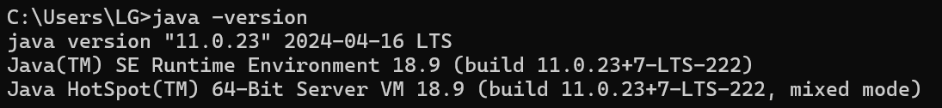
JDK 11.0.23
Download and Install:
https://www.oracle.com/java/technologies/javase/jdk11-archive-downloads.html

Slide 6
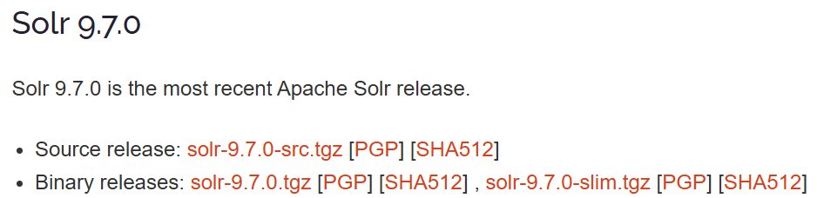
Apache Sorl 9.7.0
Download and Extract:
https://solr.apache.org/downloads.html

Slide 7

Apache Nutch 1.20
Download and Extract:
https://www.apache.org/dyn/closer.lua/nutch/1.20/apache-nutch-1.20-bin.tar.gz

Slide 8
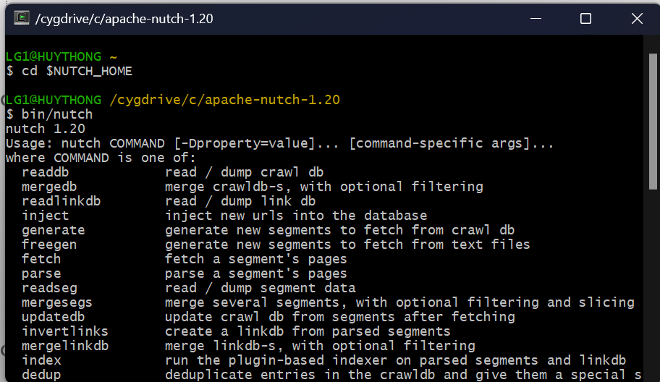
Apache Nutch 1.20
Setup Environment:
{NUTCH_HOME}/bin/nutch

Slide 9
Crawling Process

Slide 10
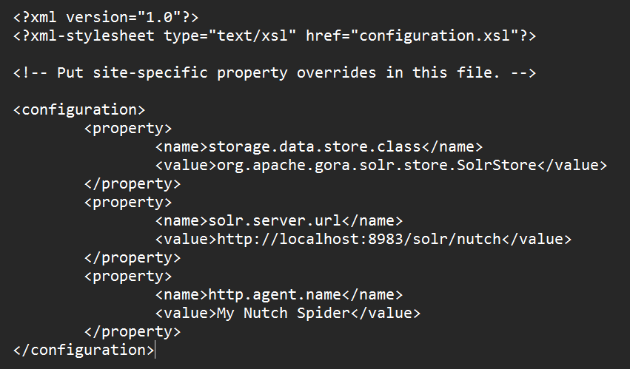
Setting
nutch-site.xml

Slide 11

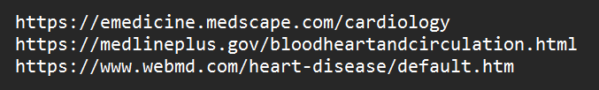
Setting
regex-urlfilter.txt
seed.txt

Slide 12
Run Solr
{SOLR_HOME}/solr star

Slide 13
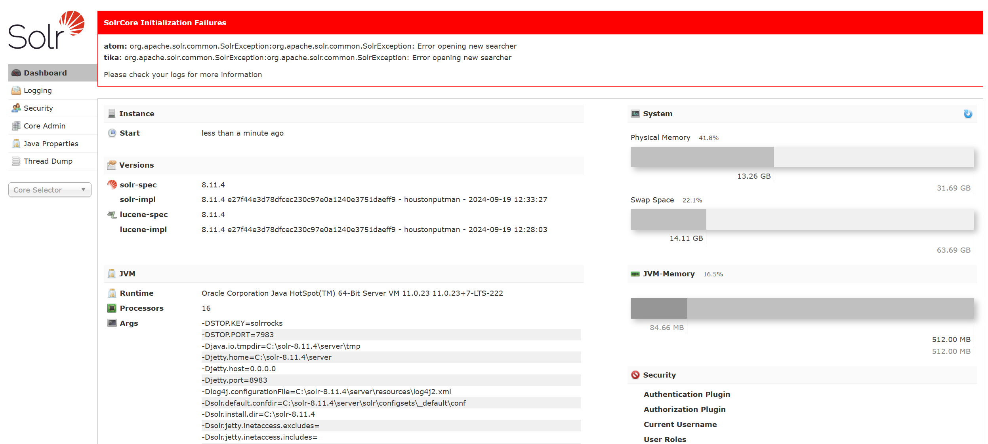

Slide 14
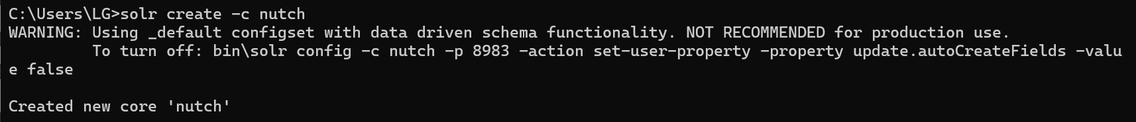
Create nutch core
{SOLR_HOME}/solr create -c nutch

Slide 15
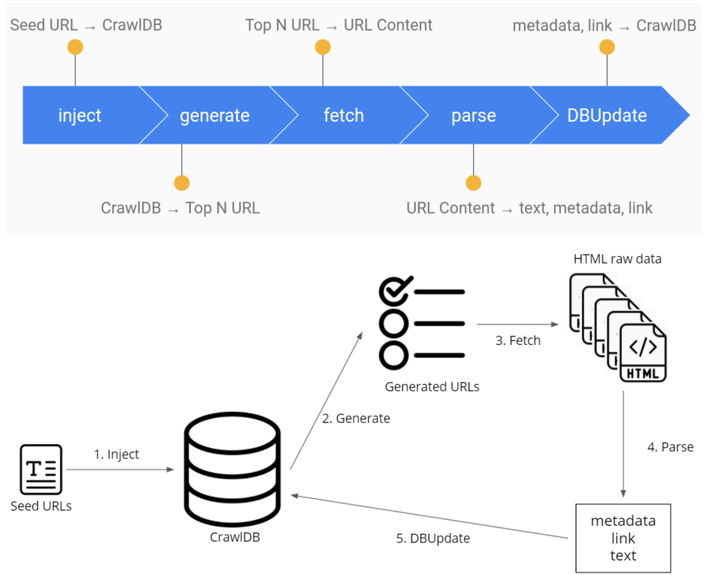

Slide 16
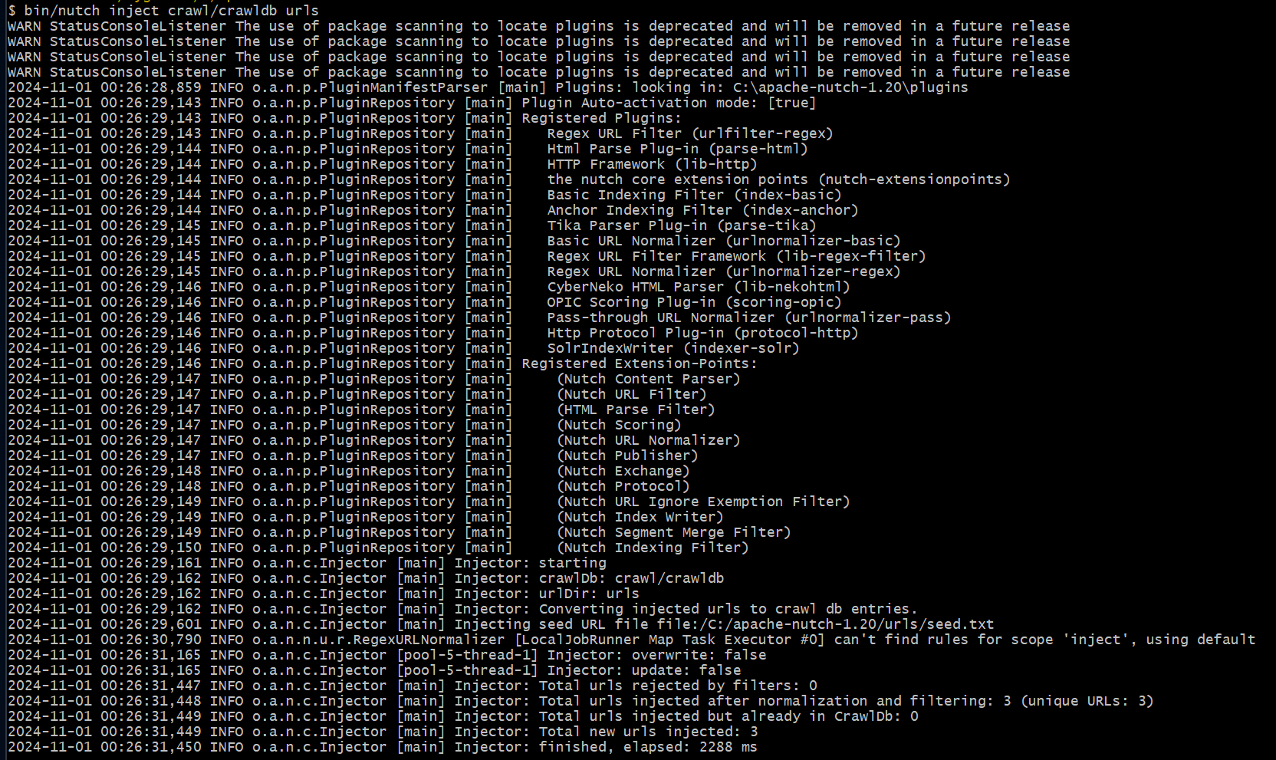
Injecting Seed URLs
bin/nutch inject crawl/crawldb urls

Slide 17
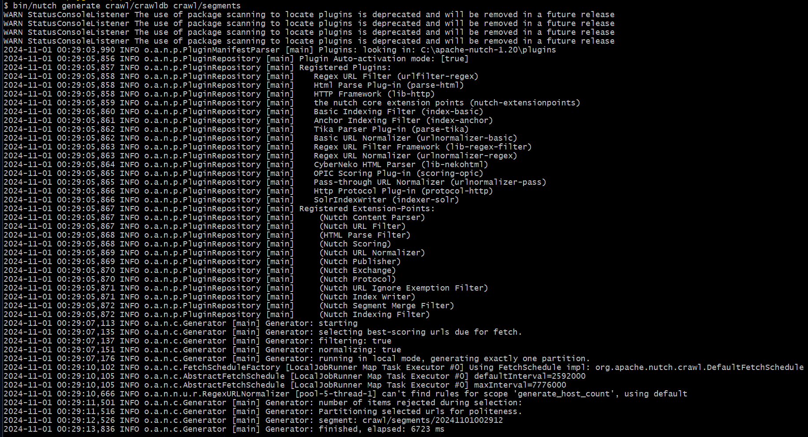
Generating Crawl Segments
bin/nutch generate crawl/crawldb crawl/segments

Slide 18
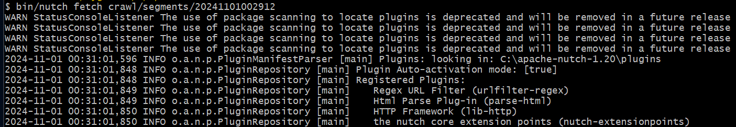
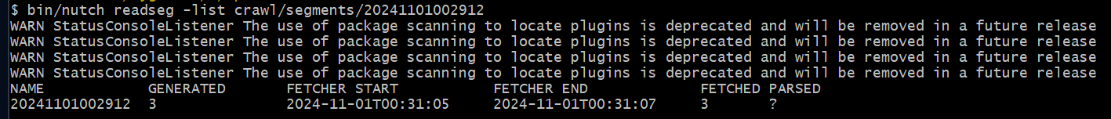
Fetching URLs
bin/nutch parse crawl/segments/20241101002912

Slide 19
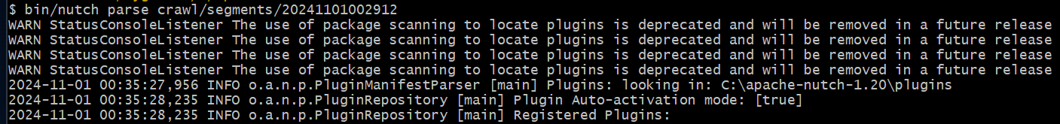
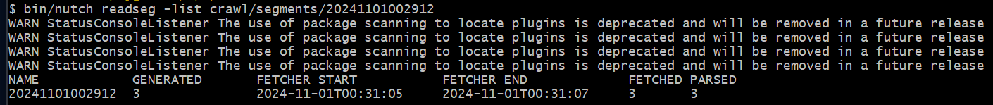
Parsing URLs
bin/nutch parse crawl/segments/20241101002912

Slide 20
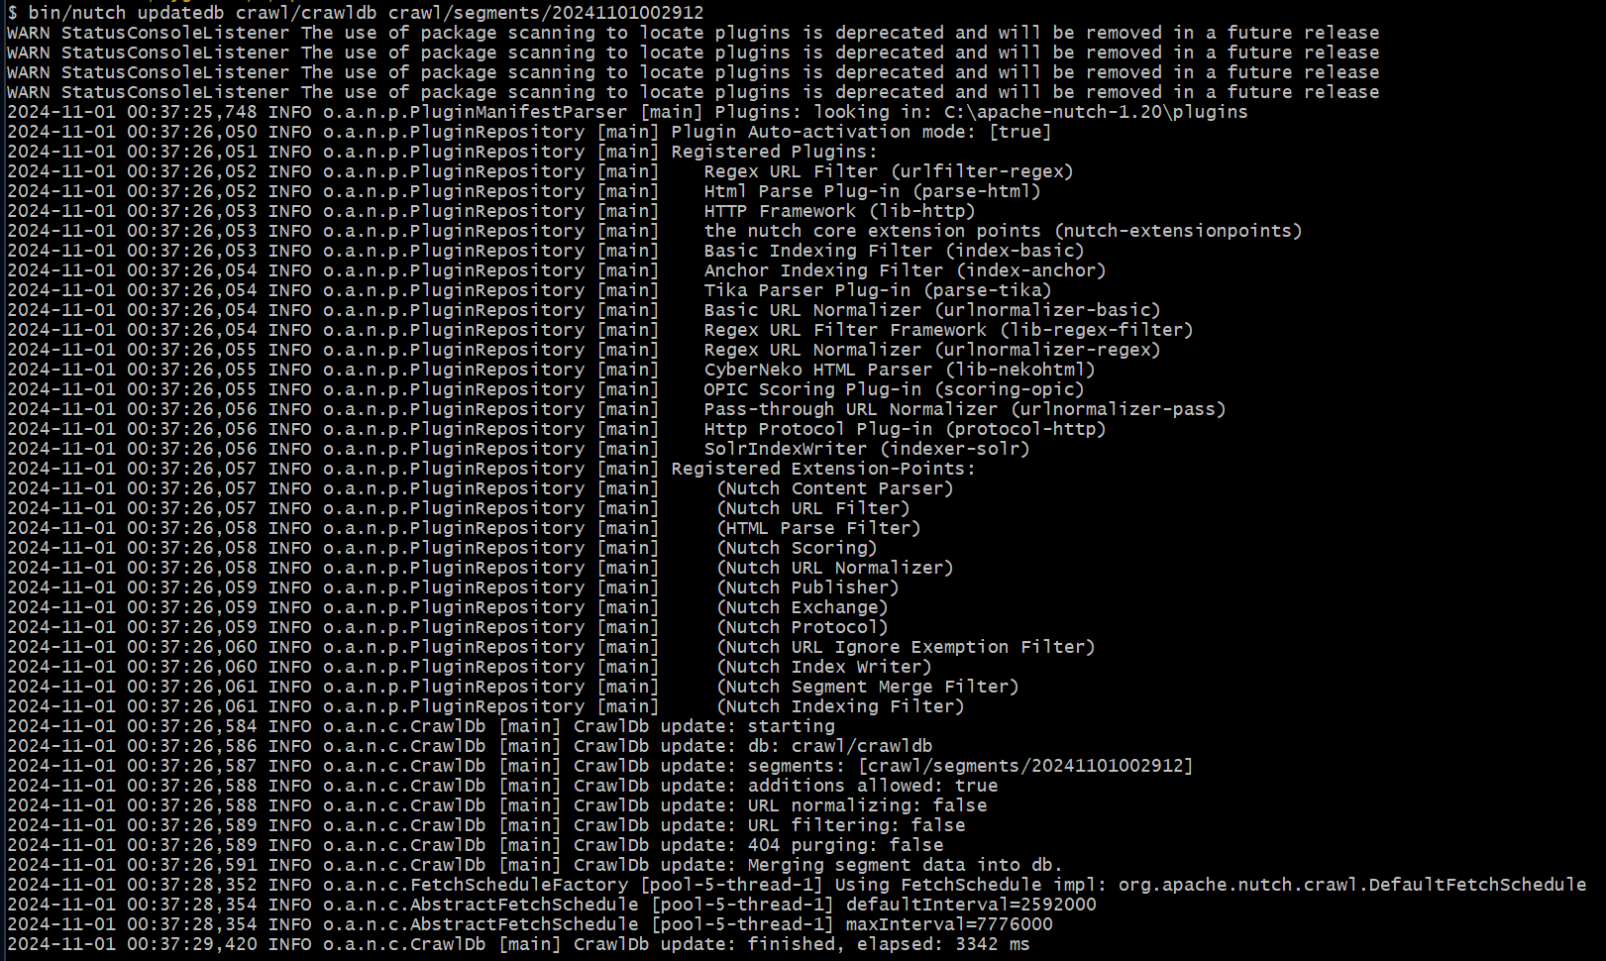
Updating the Crawl Database
bin/nutch updatedb crawl/crawldb crawl/segments/20241101002912

Slide 21
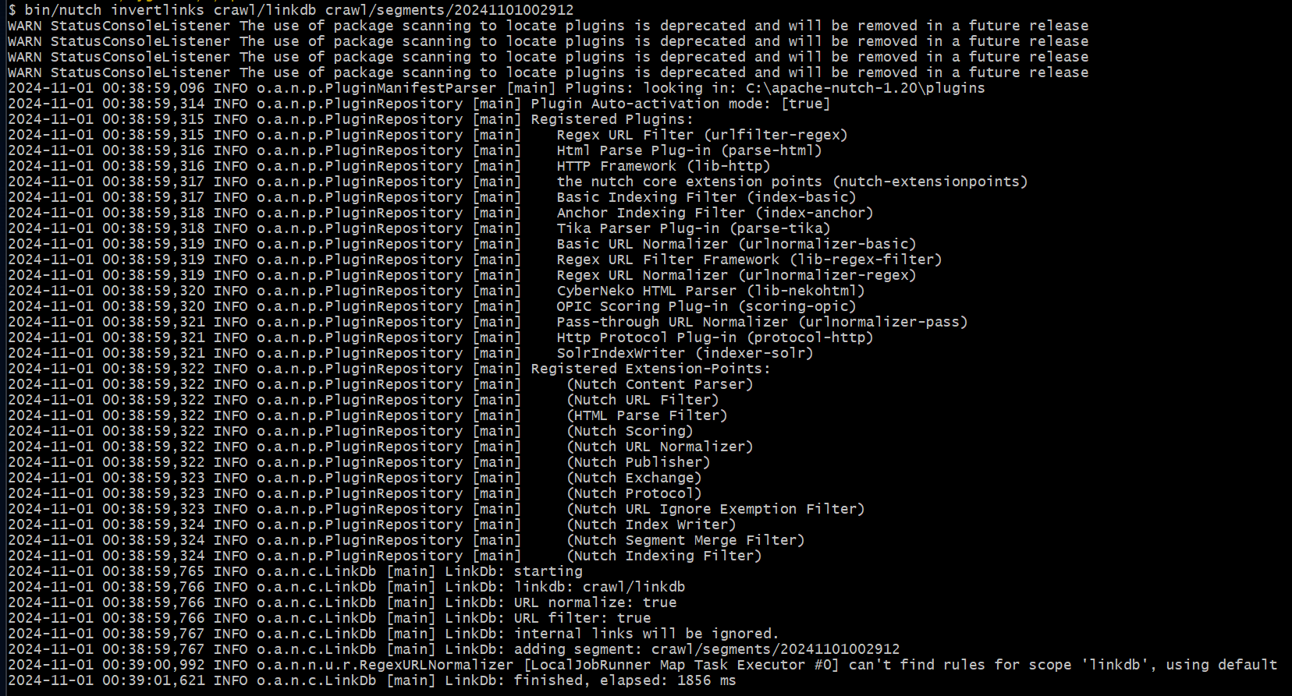
Generating an Inverted Link Database
bin/nutch invertlinks crawl/linkdb crawl/segments/20241101002912

Slide 22
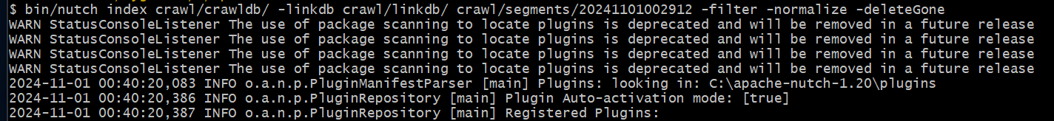
Indexing with Solr
bin/nutch index crawl/crawldb/ -linkdb crawl/linkdb/ crawl/segments/20241101002912 -filter -normalize -deleteGone

Slide 23
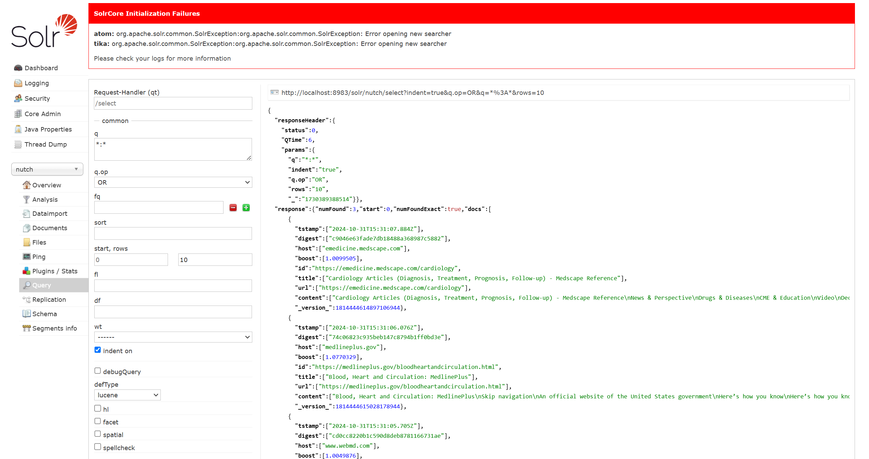
Browser Search

